Slide 1
AI-Driven SIEM Workflow Automation and Zero-Trust Endpoint Protection for Securing Cloud Supply Chains
By, Muhammed Afnaan Abdul Rahman
001466352
COMP-1252-M03-2025-2026 Msc Project

Slide 2
Table of content
Introduction
Literature review
Proposed Architecture Design
Practical Implementation
Evaluation
Conclusion
Reference

Slide 3
Introduction
Overview
This project proposes an integrated cybersecurity architectural design that utilises tools such as Elastic SIEM, Tines AI, and ThreatLocker to improve the incident lifecycle and strengthen security in cloud-based environments. It seeks to investigate how AI-driven workflow automation can make the SOC workflow intelligent and automated. While zero-trust endpoint controls can establish a robust defensive architecture, they are essential for securing cloud infrastructures against emerging threats.
Modern Security Operations Centres (SOCs) increasingly depend on cloud-enabled infrastructures and a network of dispersed endpoints, creating a complex array of security events that challenge the effectiveness of traditional SOC operations.
Conventional SOC workflows face several significant challenges, including:
An overwhelming number of security alerts
Alertness and fatigue among analysts
Analyst burnout
A reliance on manual investigation processes

Slide 4
Background Study
This background study helps us understand how cloud infrastructures have evolved from the emerging threat landscape. This evolution has led to security challenges in cloud environments. These challenges associated with cloud platforms are caused by traditional SOC workflows and their increased volume of alerts. It also reviews the expansion of AI and zero trust endpoint security solutions.
These areas provide the foundation for understanding the limitations of traditional security operations and the need for a more adaptive security approach that will serve as a resilient architecture in securing SOC workflows from the emerging threat landscape.
The background study evolves in 3 themes that includes Evolution of cloud infrastructure , AI workflow Automation and Zero Trust Architecture

Slide 5
Evolution of cloud infrastructure
Cloud environments have significantly transformed from being optional infrastructure solutions into a fundamental component of the digital world due to its scalability flexibility and reliability provided by platforms such as Aws and Azure
Despite how scalable the AWS cloud platform is when it comes to security considerations, it remains exposed to security risks that include misconfigured cloud resources, S3 buckets, insecure API configurations, and identity and access management weaknesses, increasing the attack surface of the cloud infrastructures.
AI workflow Automation
AI has been considered dominant in the industry in overcoming the limitations of traditional SIEM operations by reducing SOC challenges through its machine learning and deep learning models.
The rapid expansion of AI workloads has helped in intelligent decision-making and faster threat detection.
Zero-Trust Architecture
Zero trust architecture is based on a theoretical security philosophy of never trust, always verify, This principle asserts that no user device or endpoint can be automatically trusted, regardless of its origin.
.Zero trust moves away from traditional perimeter-based defense and emphasizes an identity-centric approach to security enforcement. It evaluates each request through continuous verification, contextual validation, and dynamic risk assessment.

Slide 6
Literature Review
The literature review analyzes existing research related to zero trust architecture, AI workflow automation, security operations centers, and cloud security vulnerabilities, all within the framework of the project titled "AI-Driven SIEM Workflow Automation and Zero-Trust Endpoint Protection for Securing Cloud Supply Chains.“
The primary purpose of conducting a literature review is to evaluate the study approaches employed by various authors in this field, identify limitations in their architectures, and pinpoint gaps that the proposed architecture aims to address.
The literature review adopts a thematic decomposition approach, examining the problem across five key domains: mainly incident response and SOC automation, zero-trust architecture, AI workflow automation.
This structural approach reflects a layered structure of cloud supply chain security, where each security component contributes to improving the overall cyber resilience of clouds and environments.

Slide 7
Incident Response and SOC automation
As We know ,Traditional SOC environments rely heavily on SIEM platforms to collect and correlate telemetry data.
However, these platforms monitor alerts based on detection rules set by the SOC team, requiring manual investigation for each alert, which causes challenges such as leading to manual triage and delayed incident response
Existing research has explored the integration of artificial intelligence and machine learning techniques into security workflows to overcome the limitations of traditional SIEM-based detection. (Farzaan et al.2026)
Random Forest : Algorithms combining decision trees to identify malicious network activity
Isolation Forest: unusual Behaviour
the Hybrid Random Forest-LSTM model neural network designed to understand patterns across sequence
Drawback(Benchmark Datasets refers hence NO complex real-world enterprises )
AI-driven automated incident response. (Narayan)
Designed an Ai –driven automated incident response framework to reduce manual investigation time on SIEM alerts to enhance the overall efficiency of security operations.
Quantitative experimental methodology by comparing performance metrics before and after implementation in SOC workflows
The researchers simulated controlled attack scenarios, including phishing, malware, DDoS, and ransomware, within a laboratory environment to evaluate the effectiveness of AI-driven incident response capabilities.(120secs)
Result: response time from 45 minutes to 10 minutes
Drawback(measuring improvements in detection and response performance rather than implementing a complete operational workflow )

Slide 8
AI Workflow
The literature review has investigated the integration of AI into SIEM platforms by developing an AI-based SIEM security email alert system that transforms alerts into structured investigation summaries (Chyun Horng Chi)
Attackers using AI techniques for automated reconnaissance and phishing campaigns must be proportionate to the incorporation of defensive AI capabilities to analyze security events at the same speed as these threats.
Developed a SIEM security email alert system capable of automatically converting raw SIEM log data into structured and customised security reports
limitation: it primarily focuses on post-detection reporting instead of addressing the complete end-to-end incident response lifecycle
the CAM 4 data breach, which approximately exposed 10.88 billion records publicly accessible to everyone due to a new misconfiguration in the Elasticsearch database lacking authentication controls.
AI should not just automate response actions such as alert escalation, notification yet it should be capable of continuously analysing, correlating and prioritising events in real time.
Zero Trust Architecture
Existing research explain( Narasapa):Zero Trust + Machine Learning + SOAR
Collecting contextual and behavioural information about users and devices, such as location, device, time, login behaviour
RAAC to calculate how risky an access request is, Isolation Forest to identify unusual behaviour ,SOAR component terminates automatically
ML identifies suspicious behaviour → Zero Trust evaluates the access risk → SOAR automatically responds.
Limitation dynamic access control and endpoint security Focusing on adaptive access control and automated endpoint response yet no Elastic SIEM alerts through Tines AI Like This research

Slide 9
Objectives
Objective 1: To design and implement AI-driven SOC workflow
To design and develop an automated SoC workflow by integrating an AWS EC2 instance with Elastic SIEM and the Tines AI workflow automation tool for real-time log collection and security monitoring.
Objective 2: Implementation of Rule-Based Detection for privileged Account activity
The purpose of this objective is to implement custom detection rules in Elastic SIEM
Objective 3: Establishment of Webhook Integration Between Elastic SIEM and Tines
This objective aims to establish an HTTP web integration between Elastic SIEM and Tines to transfer the security alerts from the Elastic SIEM dashboard to Tines for AI-driven workflow.
Objective 4: Evaluation of Zero Trust Policy Enforcement and Endpoint Behavioural Control
The aim of this objective is to explore how Zero Trust policy enforcement and endpoint behavioural control can prevent unauthorised application execution and minimise exposure to zero-day vulnerabilities on cloud endpoints through application control, storage control, and ringfencing.
Objective 5: Implementation of Rule-Based Threat Detection Using Event ID 4672
This objective emphasizes on establishing a rule-based detection approach that will use event code 4672 to detect login attempts to the cloud endpoint and then produce security warnings based on their severity.
Objective 6: AI-driven SOC alert transformation and analyst workflow optimization
This aim focuses on the establishment of an AI-driven security workflow automation that will convert raw SIEM alerts into structured, human-readable incident intelligence and automatically deliver them to security analysts through email notifications. This would reduce the requirement for security analysts to manually handle warnings.

Slide 10
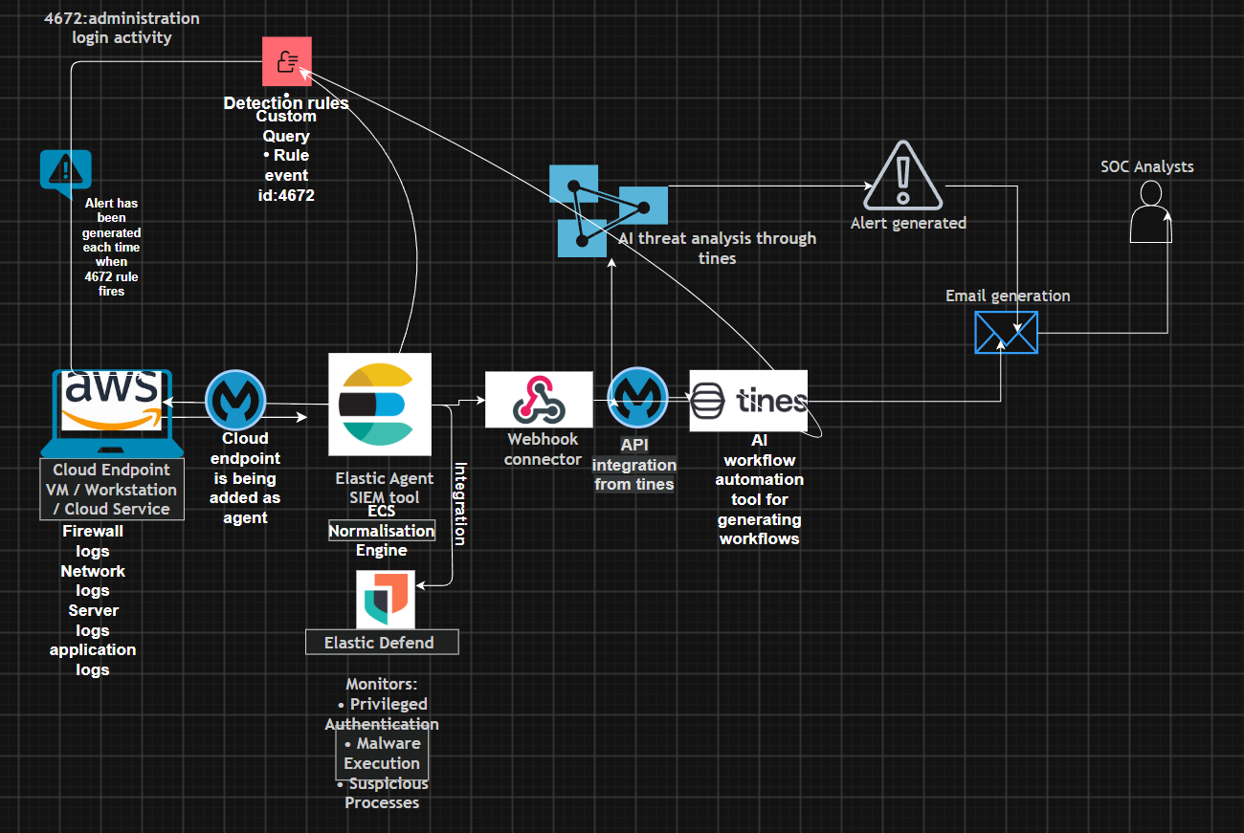
Proposed Architecture Design
The proposed architecture is displayed in two phases
Phase1:

Slide 11
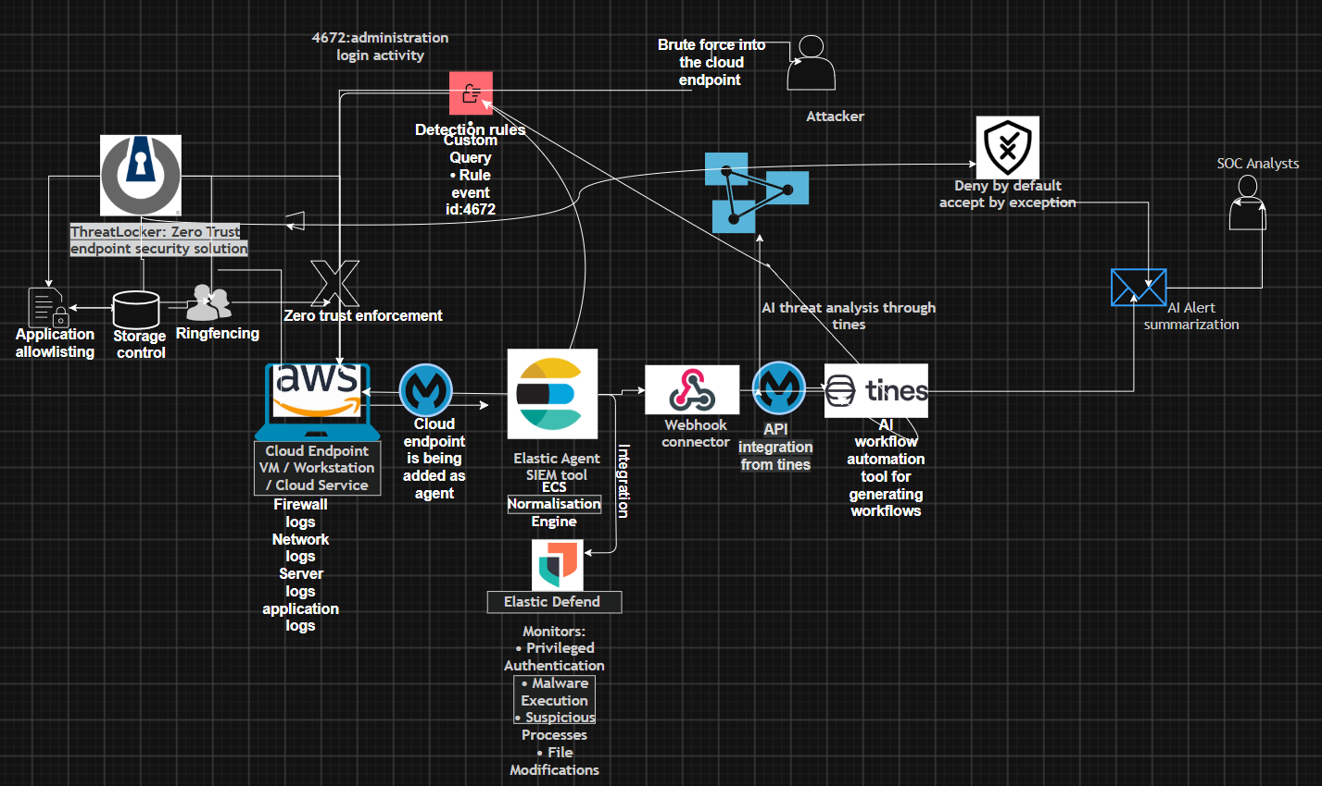
Phase 2

Slide 12
Steps
Layer 1- Cloud Endpoint
Layer 2- Endpoint Detection and Response
Layer 3- Security Information and Event Management
Layer 4 -AI-Driven Workflow Automation
Layer 5 represents a Zero Trust endpoint solution.

Slide 13
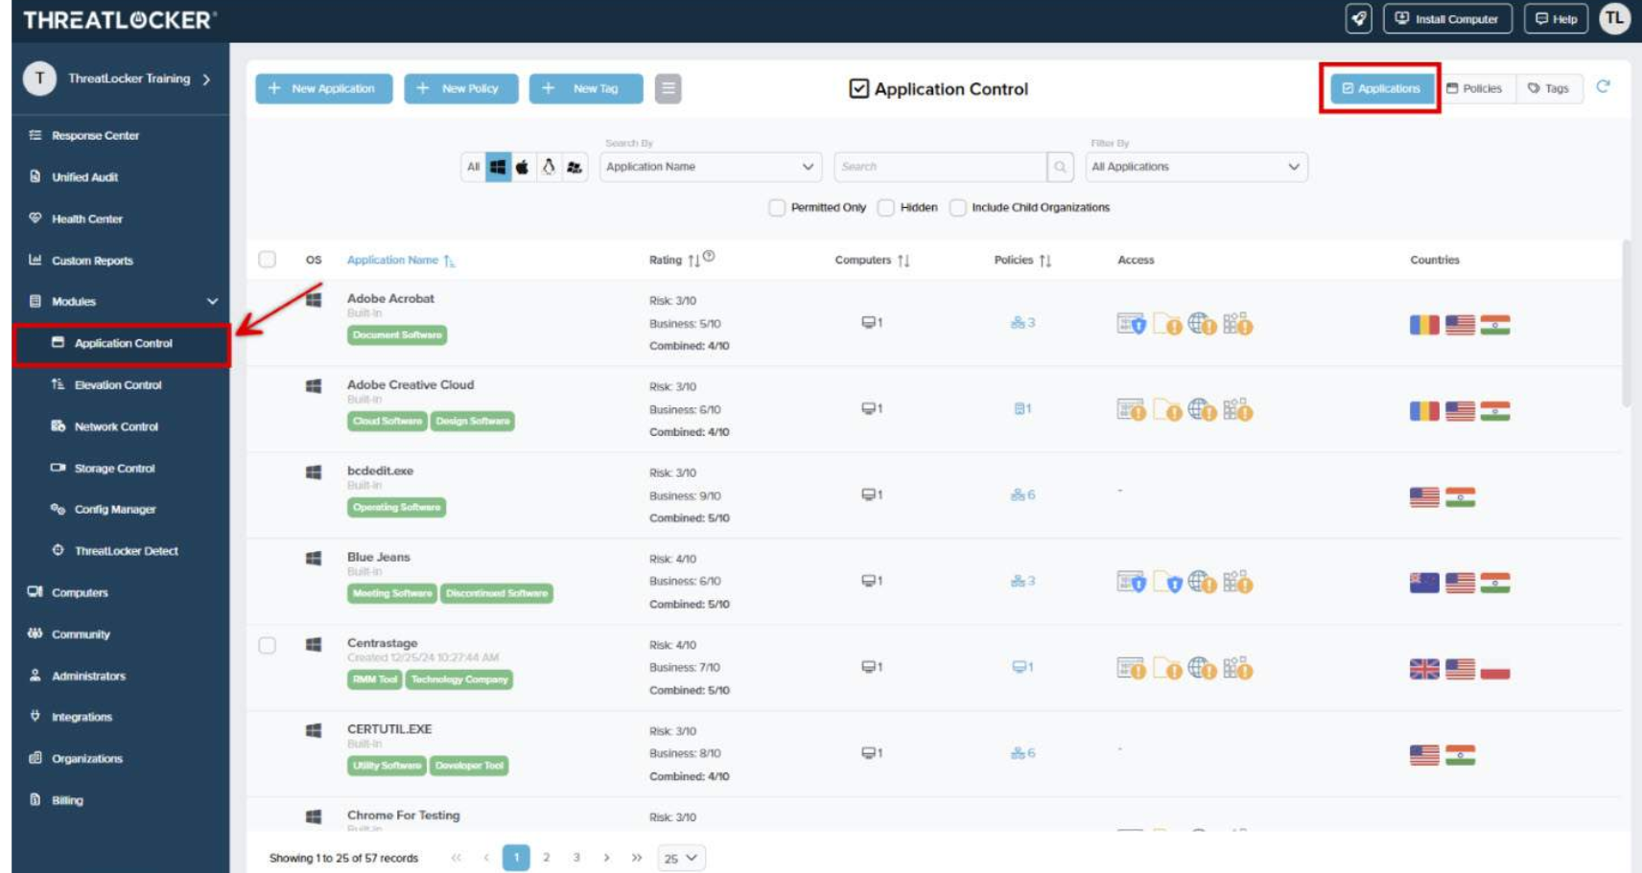

Slide 14
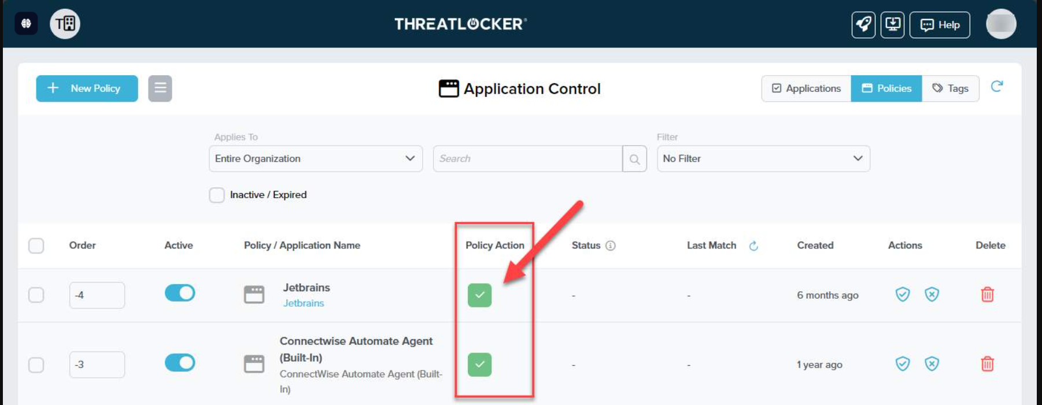

Slide 15
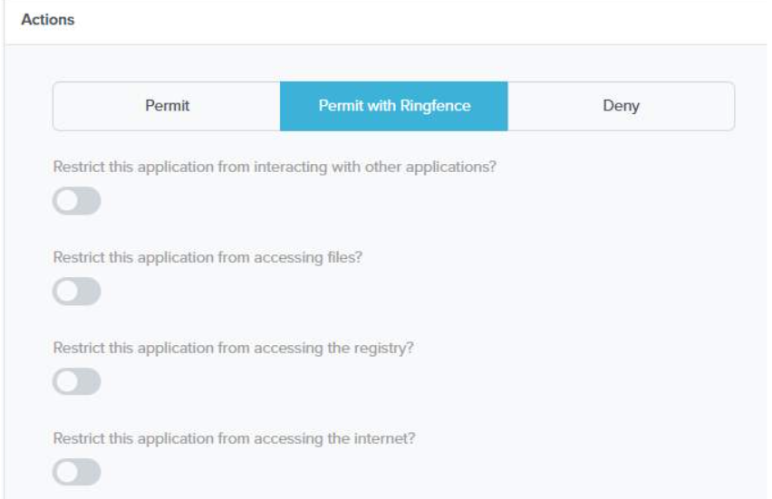

Slide 16
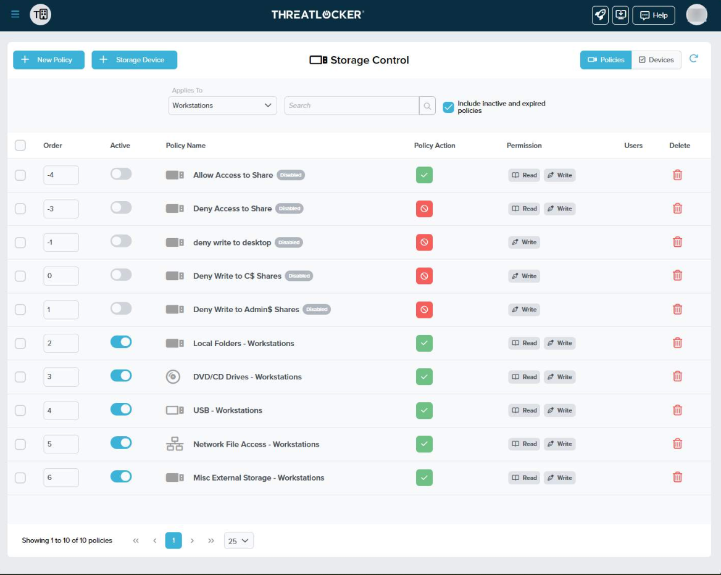

Slide 17
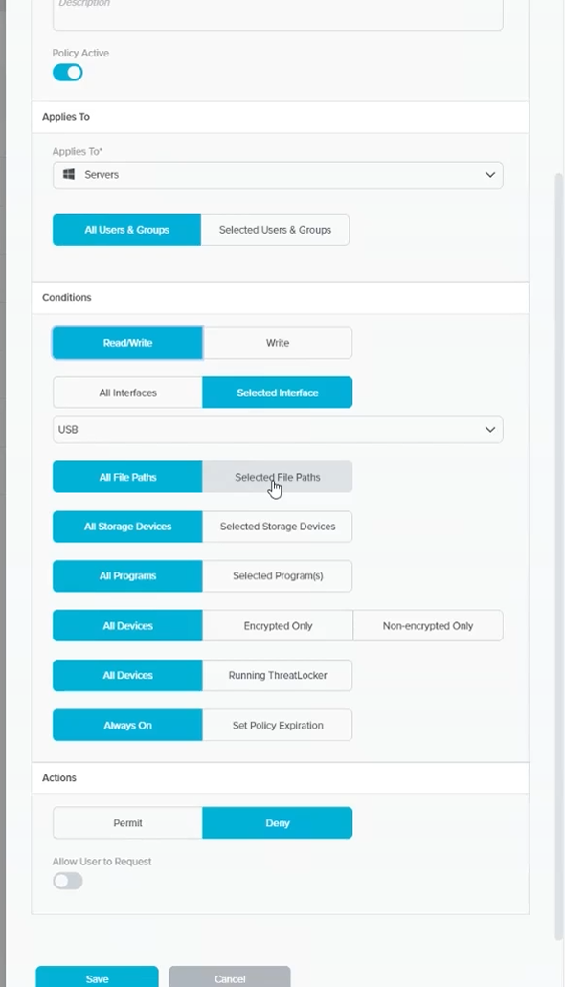

Slide 18
Evaluation
Extending Traditional SOC Workflows in cloud infrastructures
Implementation of the Principle of Least Privilege and Defence in Depth

Slide 19
Conclusion
This proposed model demonstrated the integration of AI-driven workflow automation in Elastic SIEM with zero-trust endpoint controls to enhance cloud-based security operations center workflows.
Integrating Elastic with Tines' AI workflow automation tool helps SOC workflows by transforming security alerts into structured investigation summaries that reduce manual alert analysis carried out by SOC teams.
Although ThreatLocker could not be fully demonstrated because of licensing limitations, the research critically evaluates its controls, such as default-deny architecture, application allowlisting, ring fencing, and storage control for implementing zero-trust endpoint protection.
Overall this study helps us understand how cloud environments can be more adaptive, resilient, and intelligent when facing cyber threats by combining AI and zero-trust architecture to mitigate those threats.

Slide 20
References
Adriano Serckumecka, et al. CCE: A Cloud-Based SIEM Correlation Engine Built on Serverless Functions. 29 Sept. 2025, pp. 95–105, ieeexplore.ieee.org/stamp/stamp.jsp?tp=&arnumber=11360458, https://doi.org/10.1109/srds69199.2025.00022. Accessed 4 Mar. 2026.
Anupa, J., and K. Chandra Sekaran. “Cloud Workflow and Security: A Survey.” 2014 International Conference on Advances in Computing, Communications and Informatics (ICACCI), Sept. 2014, pp. 1598–1607, ieeexplore.ieee.org/document/6968496, https://doi.org/10.1109/icacci.2014.6968496. Accessed 7 Jan. 2026.
Breachsense. “Capital One Data Breach: How 106 Million Records Were Stolen.” Breachsense.com, 2026, www.breachsense.com/blog/capital-one-data-breach-case-study/.
Carlson, Teressa. The State of Cloud-Driven Transformation.
Chyun Horng Chi, et al. Intelligent-Based SIEM Security Email Alert. 23 Aug. 2023, https://doi.org/10.1109/icoict58202.2023.10262562.
Cinque, Marcello . “Challenges and Directions in Security Information and Event Management (SIEM) - IEEE Conference Publication.” Ieee.org, 2018, ieeexplore.ieee.org/stamp/stamp.jsp?tp=&arnumber=8539170.
FARZAAN. “IEEE Xplore Full-Text PDF”: Ieee.org, 2026, ieeexplore.ieee.org/stamp/stamp.jsp?tp=&arnumber=10979487. Accessed 25 Feb. 2026.
Guha, Debanksh, et al. A Practical Implementation of Zero Trust Architecture for Securing Web-Based Applications. 16 May 2025, pp. 1–6, https://doi.org/10.1109/assic64892.2025.11158196. Accessed 13 Oct. 2025.
Kim, Dasol, et al. “A Comparative Security Analysis of Storage-Integrated Web Applications in Heterogeneous Cloud Environments.” 2025 12th International Conference on Social Networks Analysis, Management and Security (SNAMS), 25 Nov. 2025, pp. 30–37, ieeexplore.ieee.org/stamp/stamp.jsp?tp=&arnumber=11391049, https://doi.org/10.1109/snams67467.2025.11391049. Accessed 4 Mar. 2026.
Kotenko, Igor, et al. “Aggregation of Elastic Stack Instruments for Collecting, Storing and Processing of Security Information and Events.” IEEE Xplore, 1 Aug. 2017, ieeexplore.ieee.org/abstract/document/8397627. Accessed 21 Aug. 2021.
Nagababu Garigipati, et al. A Multi-Layered Hybrid Security Algorithm Based on Integrity for the Cloud Computing Environment. 19 July 2023, https://doi.org/10.1109/icecaa58104.2023.10212405. Accessed 29 Jan. 2024.
Narasappa, Dharnisha. “Integrating Zero Trust Architecture with Automation and Analytics for Resilient Cybersecurity.” 2025 3rd International Conference on Data Science and Network Security (ICDSNS), 25 July 2025, pp. 1–6, https://doi.org/10.1109/icdsns65743.2025.11168551. Accessed 12 Jan. 2026.
Narayan, Yogendra, et al. Strengthening Network Security through the Implementation of AI-Driven Automated Incident Response Systems. 18 Sept. 2025, pp. 1–5, ieeexplore.ieee.org/document/11233253, https://doi.org/10.1109/icccnp63914.2025.11233253. Accessed 7 Jan. 2026.
Sornalakshmi, K. “Detection of DoS Attack and Zero Day Threat with SIEM.” 2017 International Conference on Intelligent Computing and Control Systems (ICICCS), June 2017, https://doi.org/10.1109/iccons.2017.8250515. Accessed 19 May 2020.
Threatlocker. “Zero Trust Endpoint Security | ThreatLocker, Inc.” Www.threatlocker.com, www.threatlocker.com/.
University, Threatlocker. “Loading.” Docebosaas.com, 2026, threatlocker.docebosaas.com/learn. Accessed 7 Jan. 2026.
Wei, Yu Chih, and Tak Wai Yu. “Zero Trust Framework in Financial Sector: The Handling of Machine Learning Based Trust Management.” IEEE Xplore, 1 July 2023, ieeexplore.ieee.org/document/10226959.

